Slide 1

Intro to Azure Data Factory Pipelines

Slide 2






A BIG thank you to our 2020 Sponsors!
Platinum Sponsor (Londonderry)
Gold Sponsor (Portsmouth)
Gold Sponsor (Plymouth)
Bronze Sponsor
Bronze Sponsor

Slide 3





Another BIG thank you to supporting organizations!
This event was also made manageable by these organizations in support of free, grass-roots events like Granite State Code Camp 2020

Slide 4



About the speaker
Tom Willwerth
Senior Consultant / DBA at Straight Path Solutions www.straightpathsql.com
17 years experience – DBA, DB Dev, and various other titles
Notes:
From NH, Graduated NHCTC,

Slide 5

Agenda
What is Azure Data Factory
Why use it
Getting Started
Networking / Security
Pipelines
Data Flows
Wrap-Up

Slide 6
What is Azure Data Factory (ADF)(V2)
Integrate data silos with Azure Data Factory, a service built for all data integration needs and skill levels. Easily construct ETL and ELT processes code-free within the intuitive visual environment, or write your own code. Visually integrate data sources using more than 90+ natively built and maintenance-free connectors at no added cost. Focus on your data—the serverless integration service does the rest.
https://azure.microsoft.com/en-us/services/data-factory/
Notes:
Mention the acronyms and scope beginning at V2

Slide 7
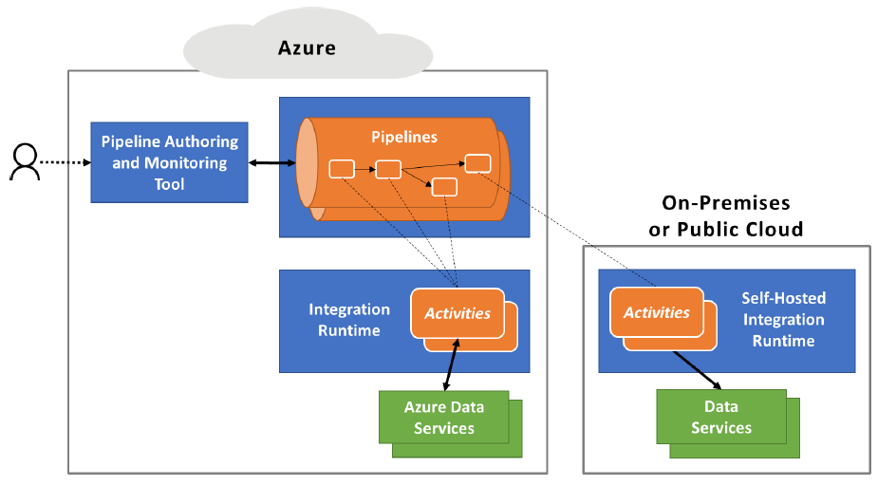
What it is, technically speaking
Web-based GUI
Services
Integration Runtime
Data Flows
Credit: https://azure.microsoft.com/mediahandler/files/resourcefiles/azure-data-factory-data-integration-in-the-cloud/Azure_Data_Factory_Data_Integration_in_the_Cloud.pdf

Slide 8
Use Cases
ETL / ELT
Orchestrate Activities
Import / Export Data
Sync DBs
Integrate services / APIs
Data warehouse loads
Job scheduling
Replace / Augment SSIS
Logic Apps type functions
One-off import/export
Notes:
Also mention any valid reasons why NOT to use ADF. This is the only mention of SSIS.

Slide 9
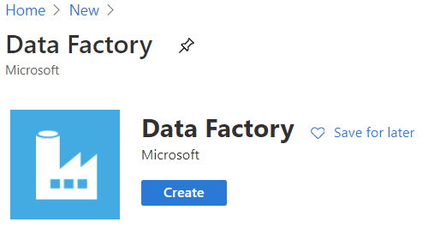
Into the Portal
Find in “Integration” category or search “Data Factory”
Easier to configure repository later

Slide 10
Network & Security
Lives in Azure
Managed VNET
Private Link
SQL & Windows Auth
Managed Identity

Slide 11
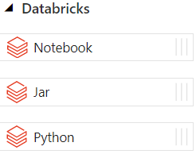
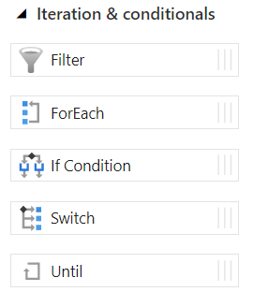
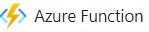


Pipelines
And more…

Slide 12
Pipelines
DEMO

Slide 13
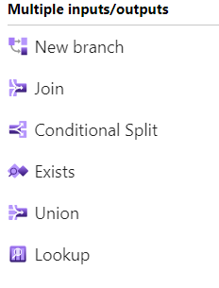
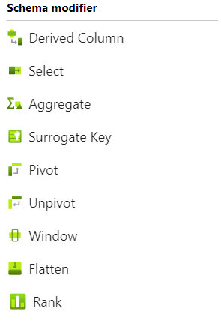
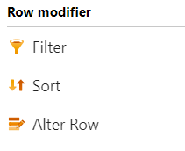
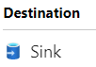
Data Flows

Slide 14
Data Flows
DEMO

Slide 15
Pipeline vs. Data flow
Pipeline | Data flow
Based on Microsoft Integration Runtime | Based on Apache Spark
Supports many Azure, SaaS, and on-premises connection types | Only supports Azure and Snowflake connections
Pipeline expressions | Data Flow expressions
Data movement consumes DIU-hours | Consumes vCore-hours
Fast initialization | 5-7 minutes of spin-up time
Mostly focused orchestration | Reduces need for SQL queries/commands
Notes:
Both very powerful!

Slide 16
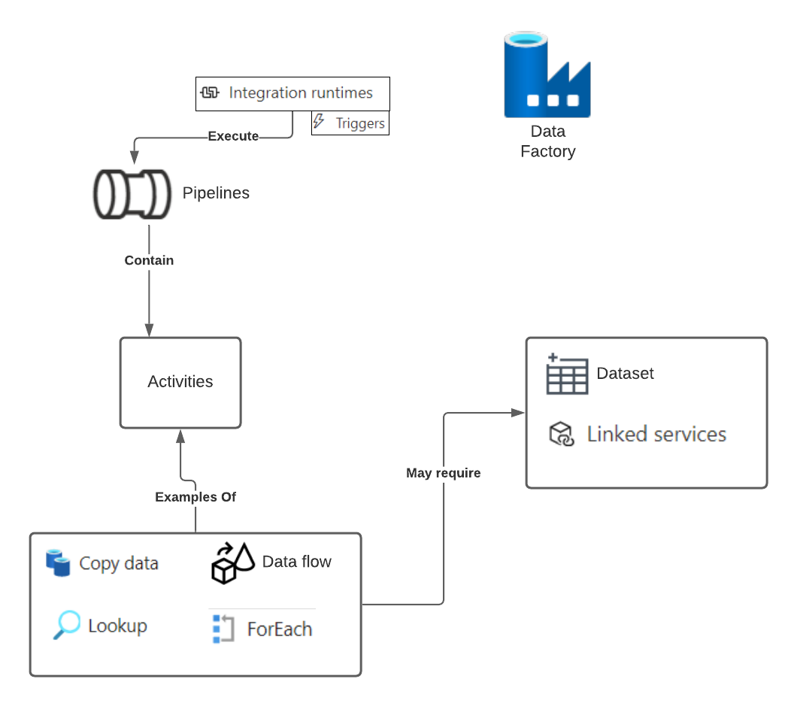
Architecture Review

Slide 17

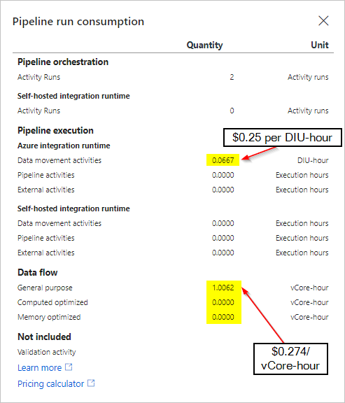
Pricing…
“It’s complicated”
Changes design strategy
Egress not included
Debug isn’t free
This Photo by Unknown Author is licensed under CC BY-SA-NC
A non-optimal, yet, real Data flow example:
6 mins x Tables x Targets
6 x 2 x 2 = 24 mins
24 x 8 = 192 mins
192 = 3.2 hours
3.2 x 0.274 = 0.8768
0.8768 x 24 x 30 = $631.30
https://azure.microsoft.com/en-us/pricing/details/data-factory/data-pipeline/

Slide 18
Wrap-up & Additional Learning
Did you get all that?
Questions?
Other resources:
https://cathrinew.net/adf – Blog with presentations
Videos & Tutorials in the Data Factory GUI
https://docs.microsoft.com/en-us/azure/data-factory
https://entdna.com – Training
Wine data (CC BY-NC-SA 4.0) https://www.kaggle.com/zynicide/wine-reviews

Slide 19




Thank You!
@TomWillwerth
linkedin.com/in/TomWillwerth
github.com/tkwj
Tom.Willwerth@straightpathsql.com

